Slide 1
Course Computer Vision AMSE -2024
Nicolas Griselin
"This document is the property of AIRBUS, no part of it shall be reproduced or transmitted without express prior written authorization of AIRBUS and its contents shall not be disclosed". © AIRBUS 2024

Slide 2
General Information
Contact:
Email address: nicolas.griselin@airbus.com
Organisation:
Lectures (12h):
- 18th October 2024 (6h)
- 25th October 2024 (6h)
Theory and exercises during sessions
Examination :
Individual projects
Software:
Python

Slide 3
General Information
Goal of the course:
To cover the main aspects of Machine Learning for Computer Vision
Content:
Day 1:
Introduction to Computer Vision
Basic Image Representation
Image Manipulation
Histograms and Thresholdings
Image Filtering and Enhancement
Feature Detection and Extraction
Image Segmentation
Day 2:
Introduction to Machine Learning
Hands On Exploratory Data Analysis (EDA)
Machine Learning for Computer Vision
Hands On Machine Learning for Computer Vision
Deep Learning for Computer Vision

Slide 4
Course Objective
The objective of this course is to provide participants with a comprehensive understanding of computer vision by covering both foundational and advanced techniques.
By the end of the course, you will:
Understand key image processing concepts such as filtering, feature extraction, and segmentation.
Gain hands-on experience with tools like OpenCV and Python for image manipulation and analysis.
Explore advanced topics, including deep learning, convolutional neural networks (CNNs), and object detection.
Develop the skills to apply computer vision techniques to real-world problems such as object recognition, image classification, and segmentation.

Slide 5
Chapter 1: Introduction to Computer Vision
AMSE - Course on Computer Vision - 2024

Slide 6
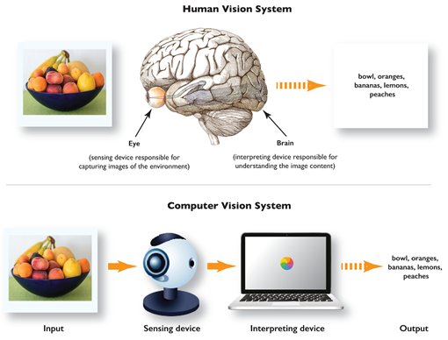
What is Computer Vision (CV) ?
Definition: Computer Vision is a field of artificial intelligence (AI) that enables machines to interpret and understand visual information from the world, such as images and videos. By simulating human vision, computer vision systems can analyze and extract meaningful insights from visual data, allowing machines to perform tasks that typically require human visual perception.

Slide 7
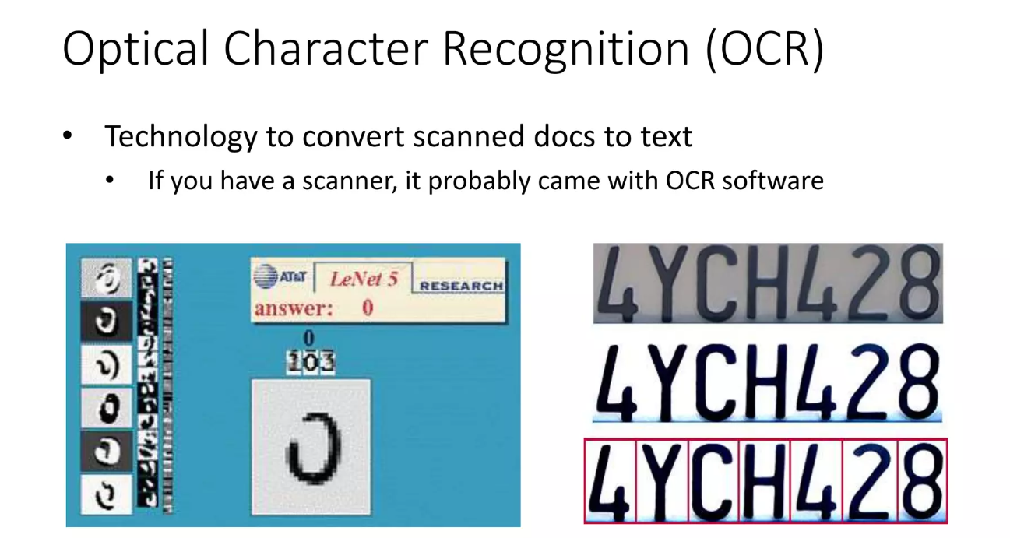
Applications of Computer Vision ?

Slide 8
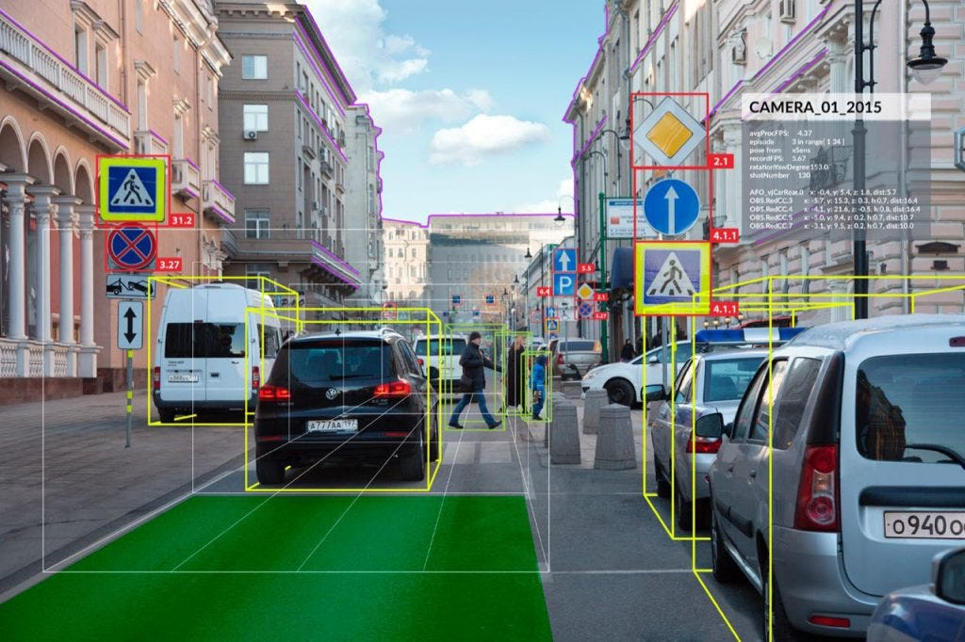
Applications of Computer Vision ?
Autonomous Vehicles

Slide 9
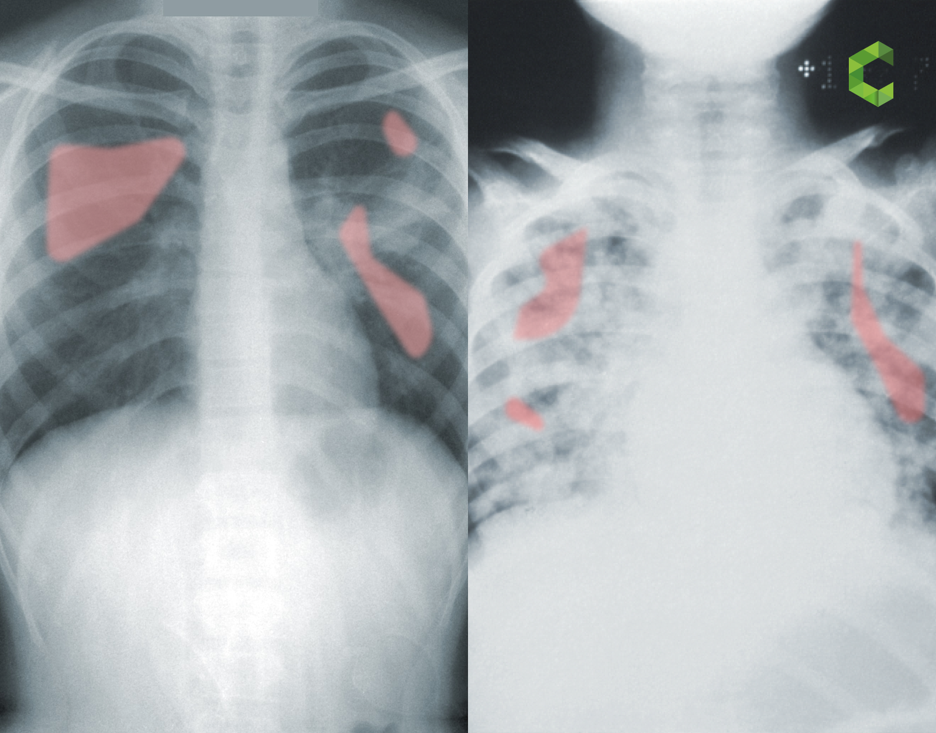
Applications of Computer Vision ?
Medical Imaging

Slide 10
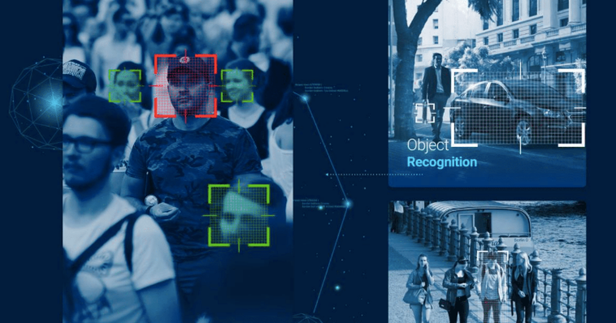
Applications of Computer Vision ?
Security and Surveillance

Slide 11
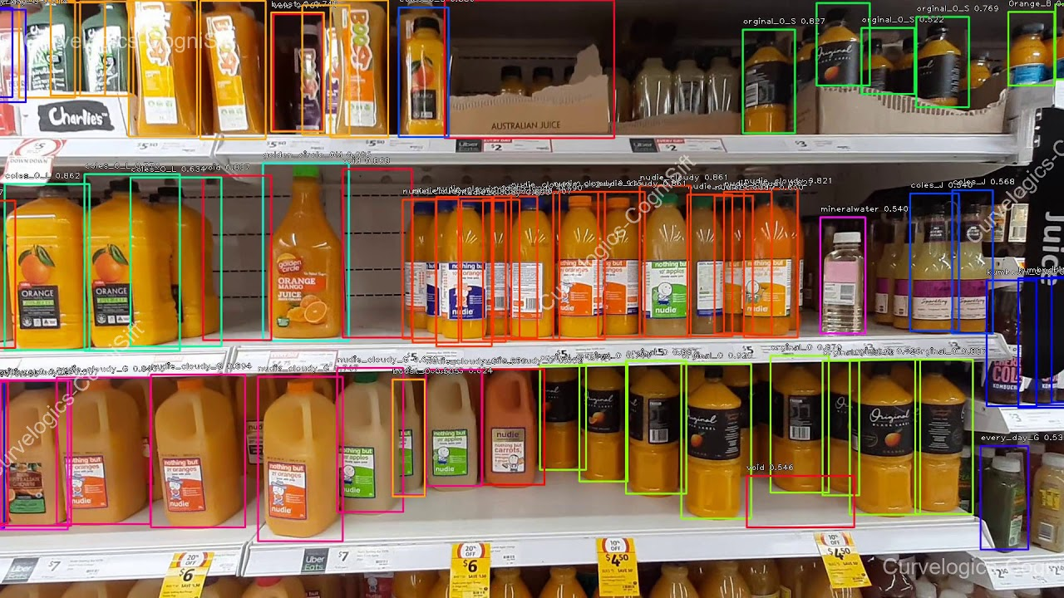
Applications of Computer Vision ?
Retail and Inventory Management

Slide 12
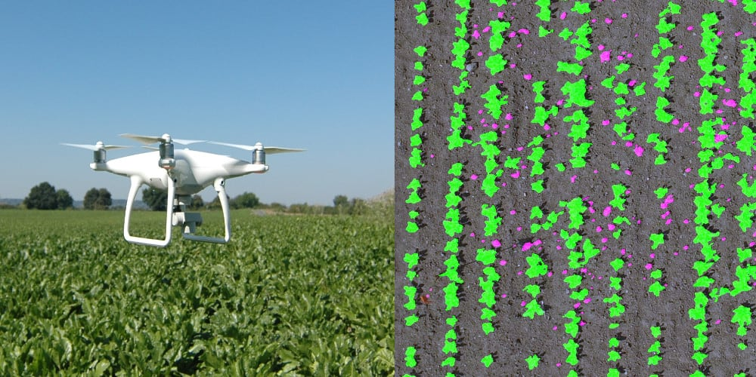
Applications of Computer Vision ?
Agriculture

Slide 13

Applications of Computer Vision ?
Augmented and Virtual Reality (AR/VR):

Slide 14
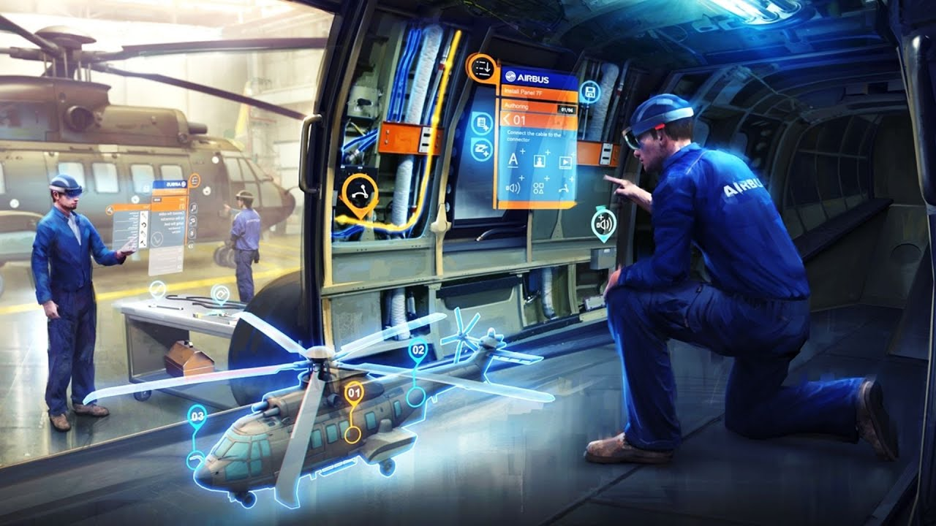
Applications of Computer Vision ?
Augmented and Virtual Reality (AR/VR):

Slide 15
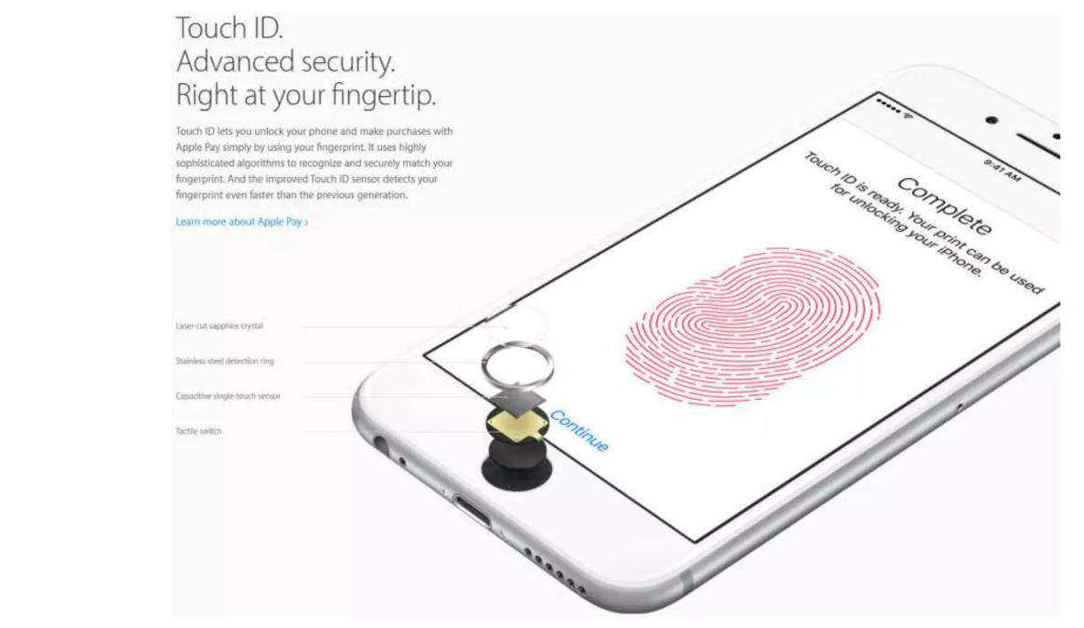
Applications of Computer Vision ?
Fingertip Recognition

Slide 16

Applications of Computer Vision ?
Facial Recognition

Slide 17
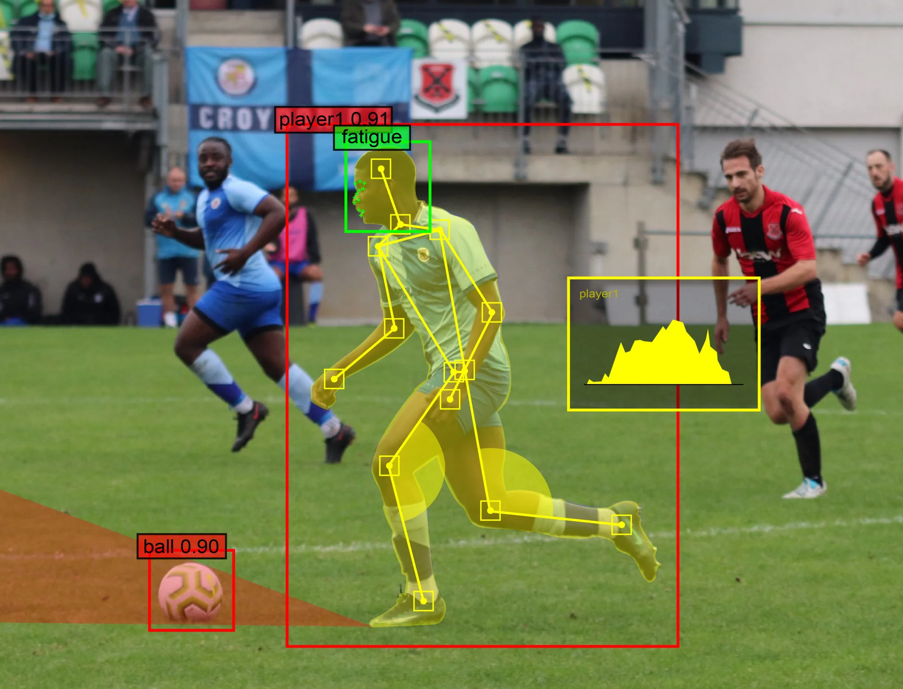
Applications of Computer Vision ?
Sports Analytics

Slide 18

Defects Detection in Rotor Composite Parts using A.I.
Applications of Computer Vision ?
Manufacturing and Quality Control

Slide 19

01
Background
"This document is the property of AIRBUS, no part of it shall be reproduced or transmitted without express prior written authorization of AIRBUS and its contents shall not be disclosed". © AIRBUS 2024

Slide 20


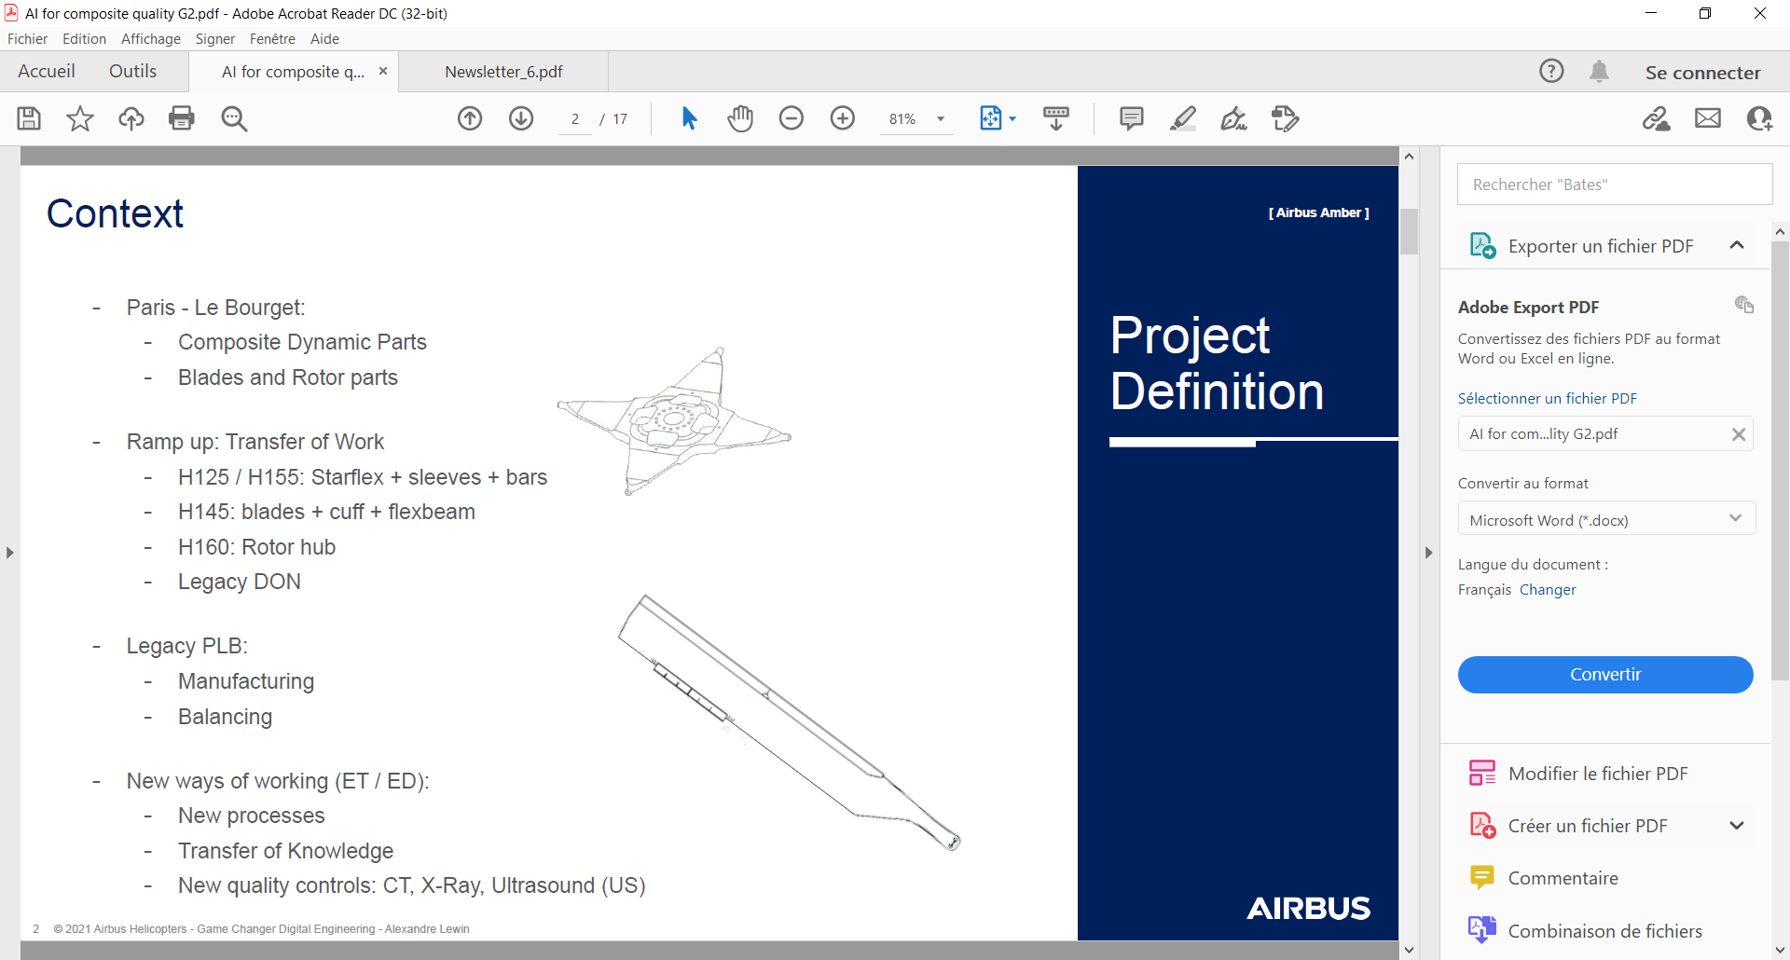

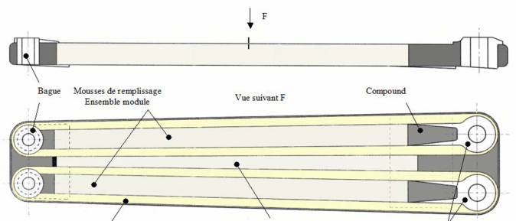
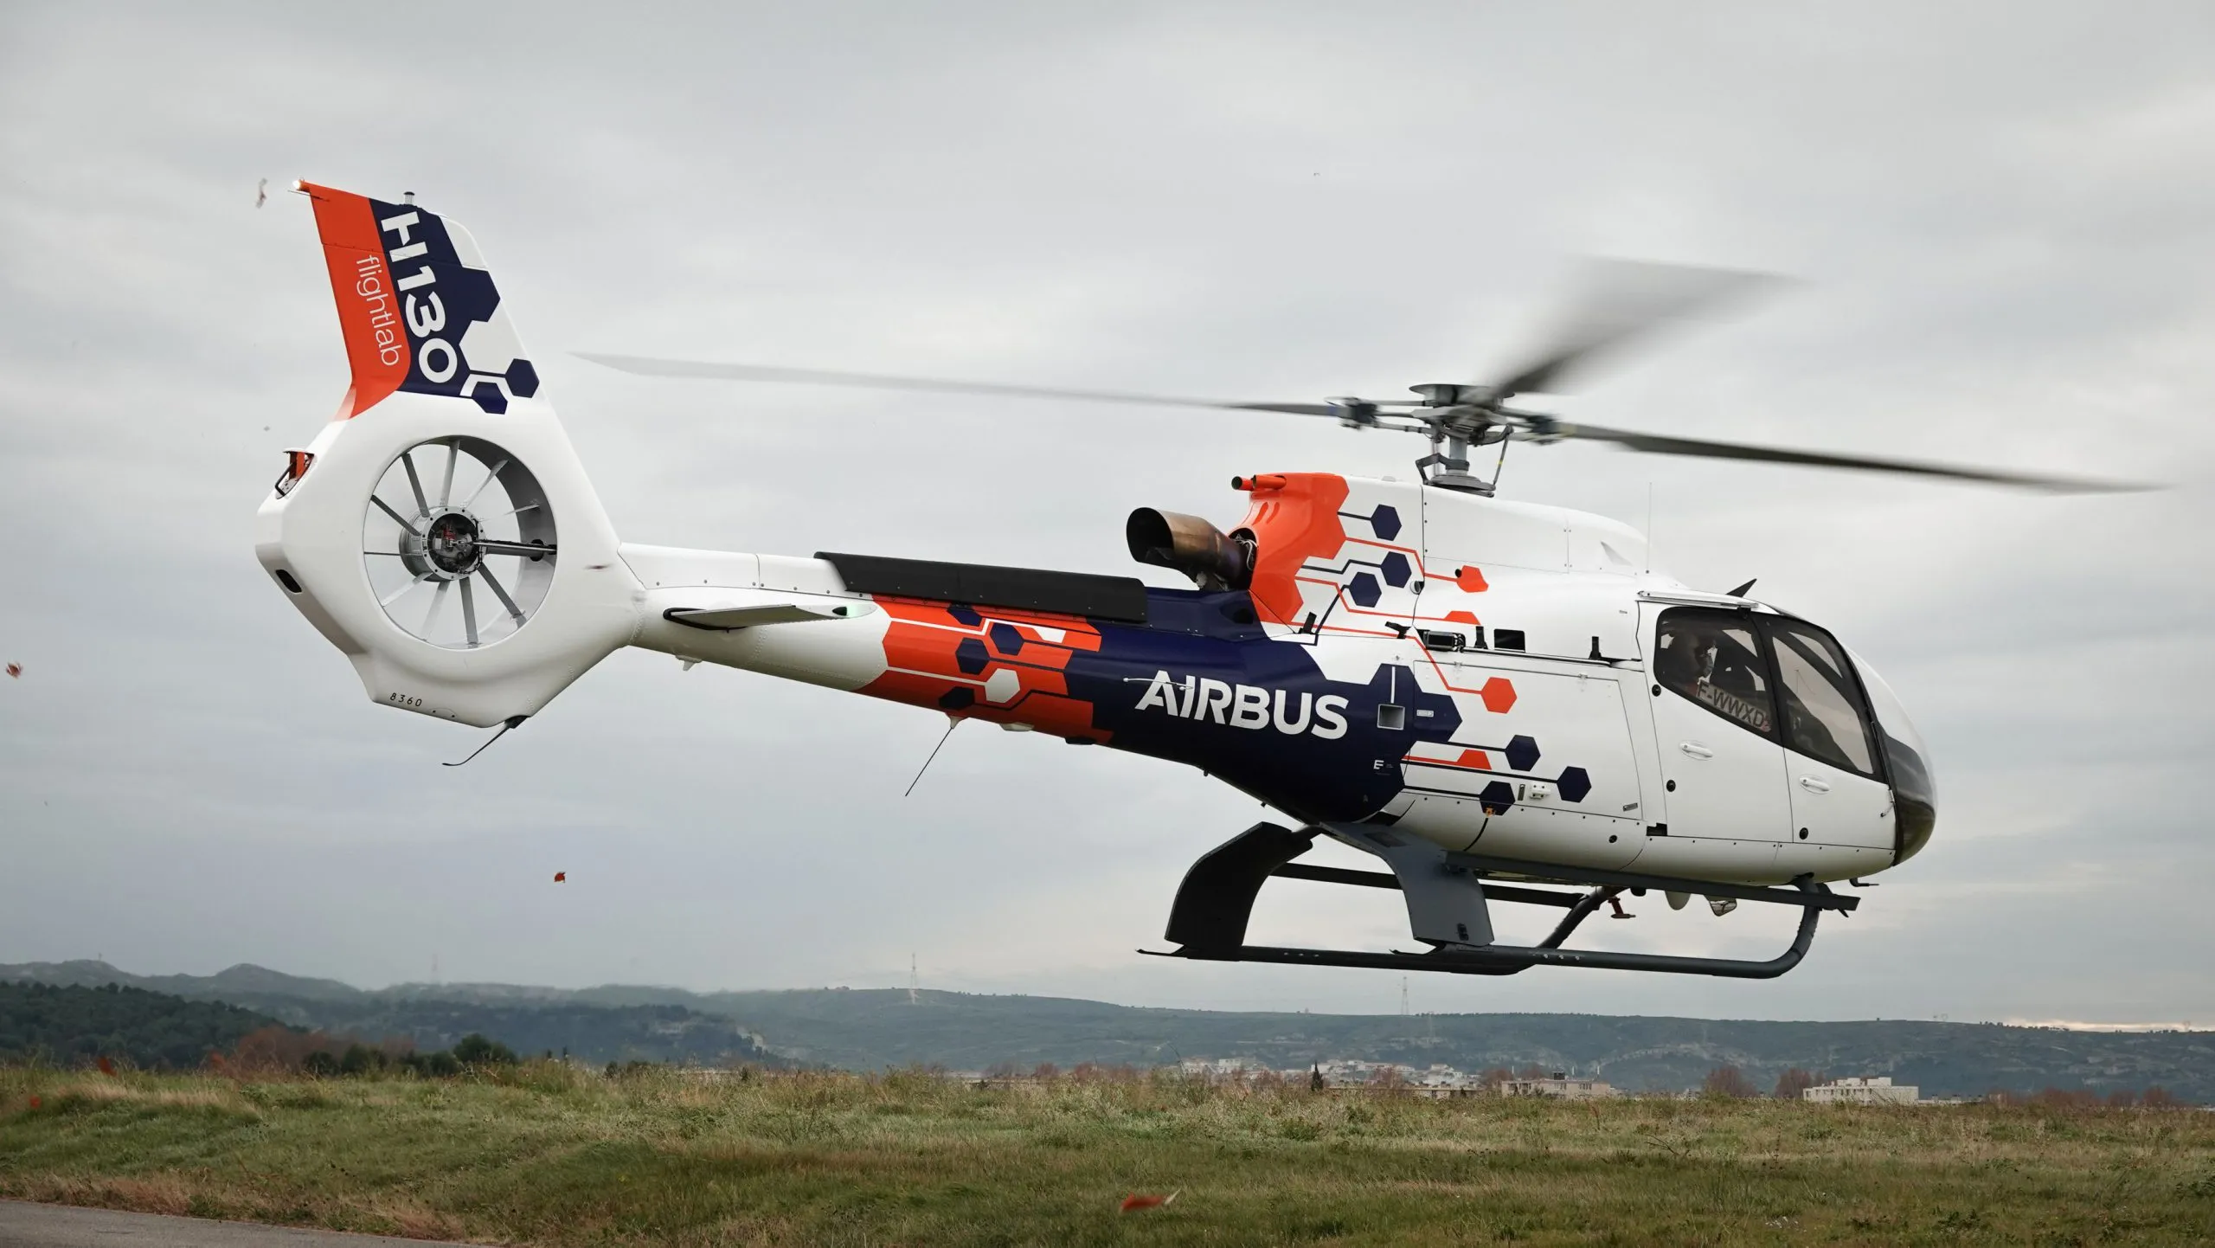
COMPOSITE PART on Aircrafts
STARFLEX (HUB)
SLEEVE
BLADE
Data
"This document is the property of AIRBUS, no part of it shall be reproduced or transmitted without express prior written authorization of AIRBUS and its contents shall not be disclosed". © AIRBUS 2024

Slide 21
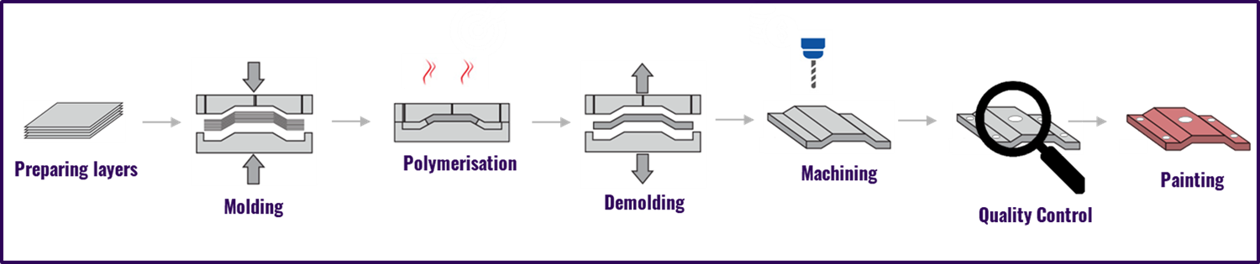
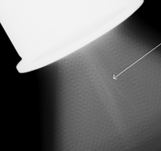
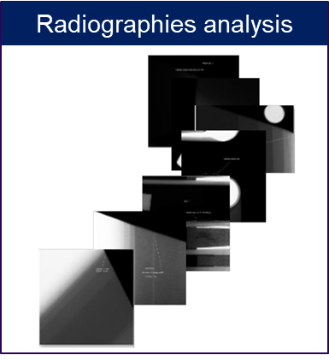
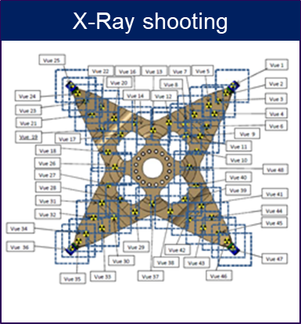
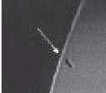
COMPOSITE PART Manufacturing
STARFLEX (HUB)
Defect
Defect
20 differents type of defects
Defect
"This document is the property of AIRBUS, no part of it shall be reproduced or transmitted without express prior written authorization of AIRBUS and its contents shall not be disclosed". © AIRBUS 2024

Slide 22
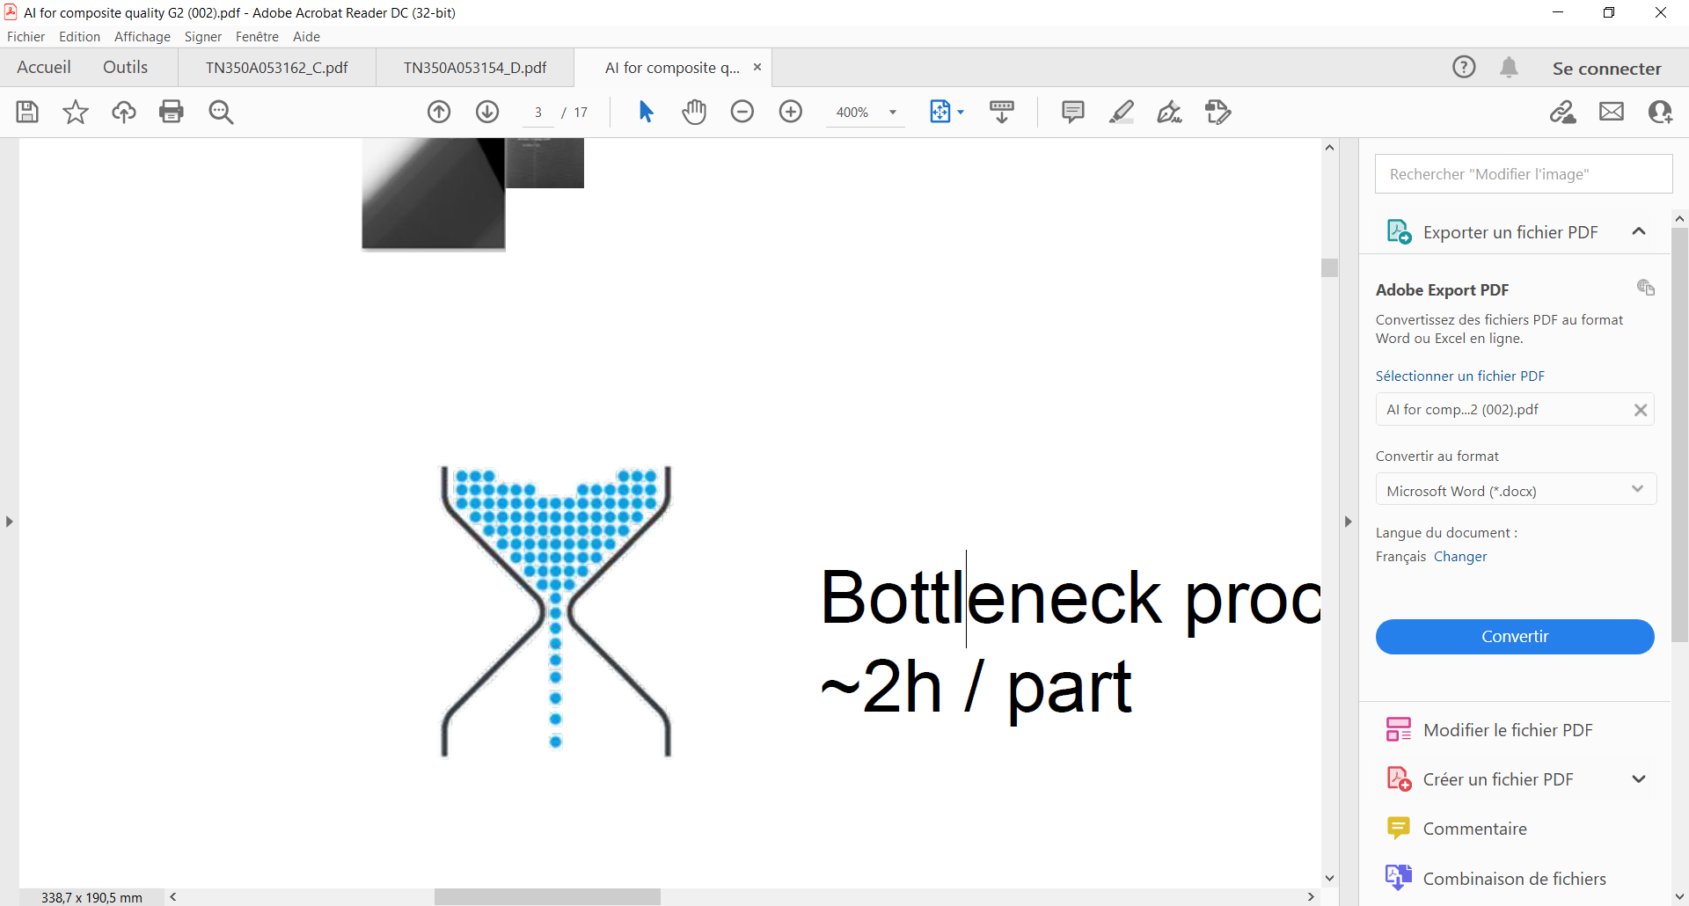
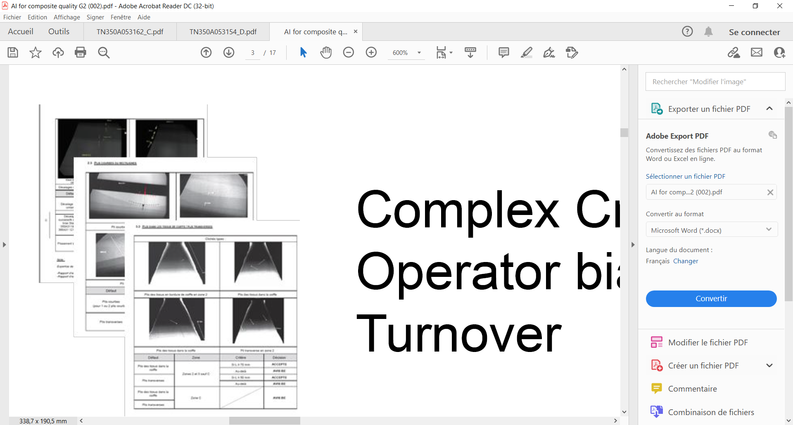
QUALITY CONTROL - Current Situation
Time consuming process
Up to 50 images for 1 part
~1h / part
100 000 images / year
Bottleneck situation
Big batch produced at once
Crisis mode (when many defects)
Human Dependent
Skilled Qualified Inspector
Complex criteria interpretation
Human detection bias
"This document is the property of AIRBUS, no part of it shall be reproduced or transmitted without express prior written authorization of AIRBUS and its contents shall not be disclosed". © AIRBUS 2024

Slide 23
02
Using A.I.
"This document is the property of AIRBUS, no part of it shall be reproduced or transmitted without express prior written authorization of AIRBUS and its contents shall not be disclosed". © AIRBUS 2024

Slide 24

DEFECT DETECTION on RADIOSCOPIES using AI
Automatic defects detection
using Artificial Intelligence (AI)
Defect
Defect
Defect
Defect
Defect
Defect
Defect
"This document is the property of AIRBUS, no part of it shall be reproduced or transmitted without express prior written authorization of AIRBUS and its contents shall not be disclosed". © AIRBUS 2024

Slide 25
03
How ?
"This document is the property of AIRBUS, no part of it shall be reproduced or transmitted without express prior written authorization of AIRBUS and its contents shall not be disclosed". © AIRBUS 2024

Slide 26
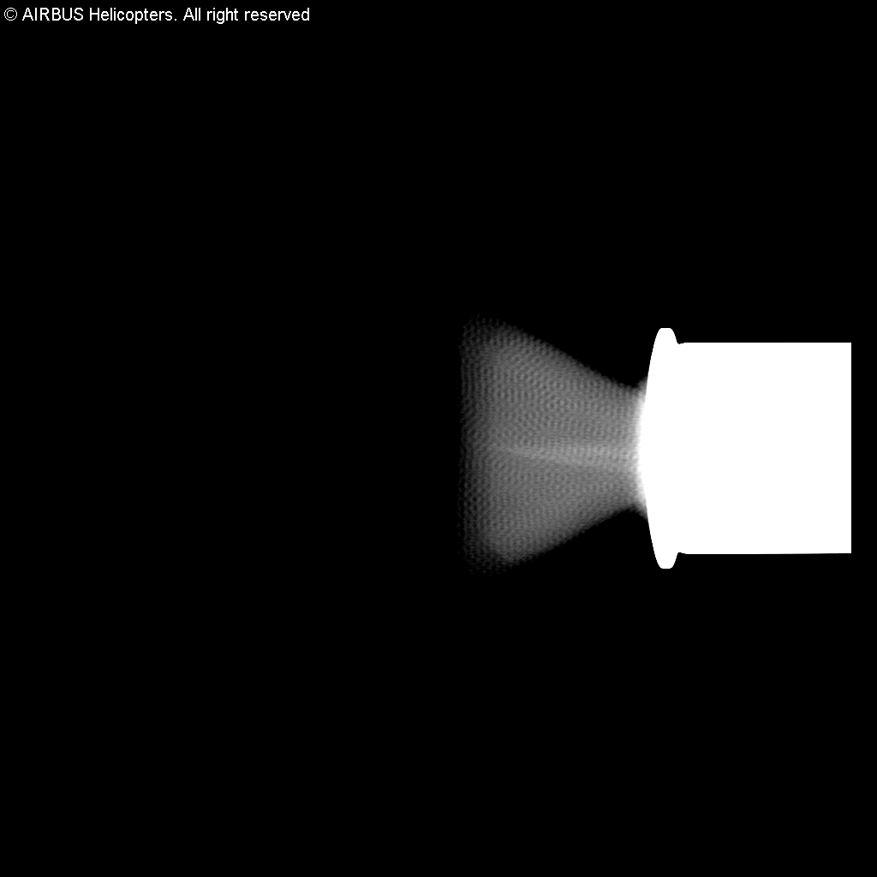
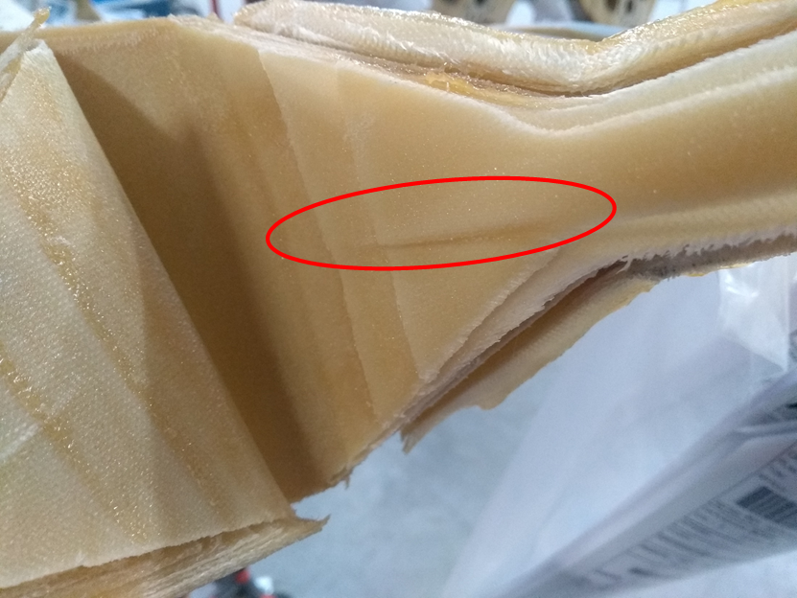
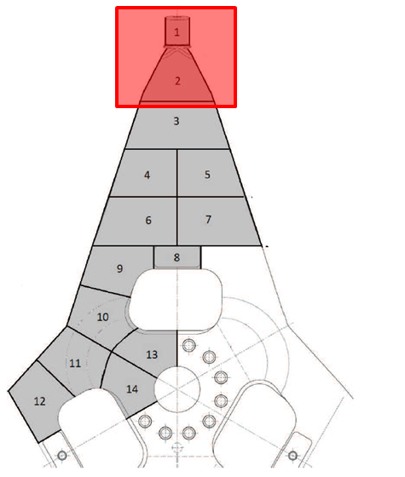
DEFECT DETECTION on RADIOSCOPIES using AI
Defect considered : wrinkle (out of plane ripple)
26
"This document is the property of AIRBUS, no part of it shall be reproduced or transmitted without express prior written authorization of AIRBUS and its contents shall not be disclosed". © AIRBUS 2024

Slide 27
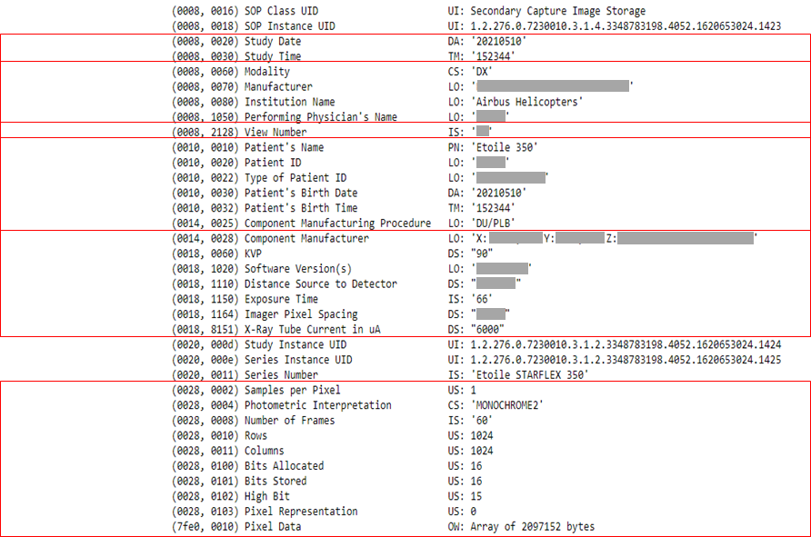

DEFECT DETECTION on RADIOSCOPIES using AI
Meta data
Image
DICOM file format :
Date and Time of picture
Machine used, Company, Operator…
View Number
Info on part
Info on X-Ray shooting parameters
Info on picture output parameters
Grayscale image, 1024 x 1024 pixels, 16 bits
PNG format (lossless format)
27
"This document is the property of AIRBUS, no part of it shall be reproduced or transmitted without express prior written authorization of AIRBUS and its contents shall not be disclosed". © AIRBUS 2024

Slide 28
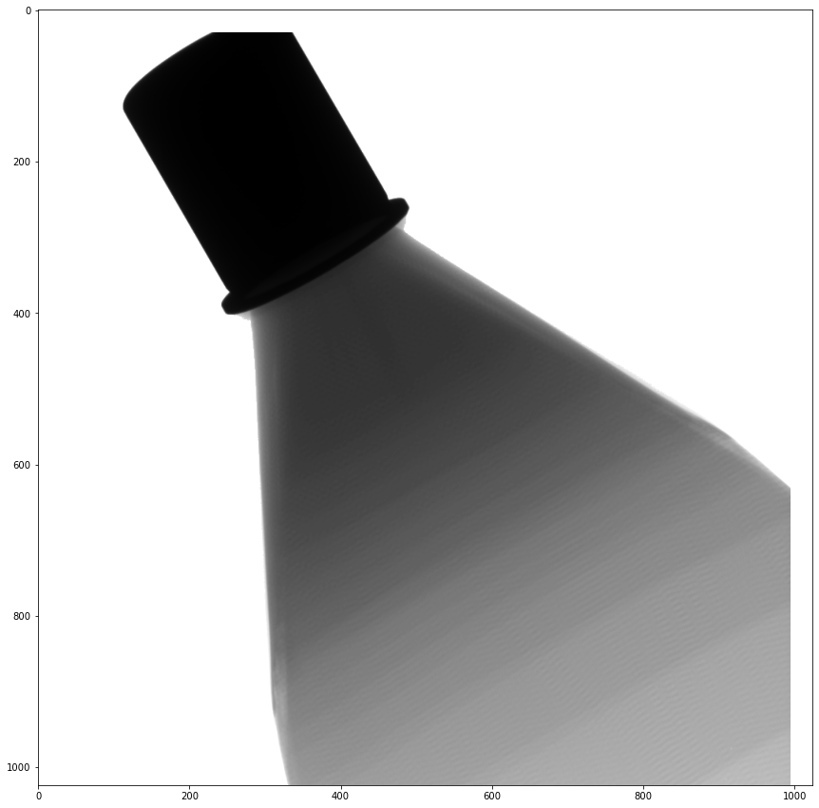
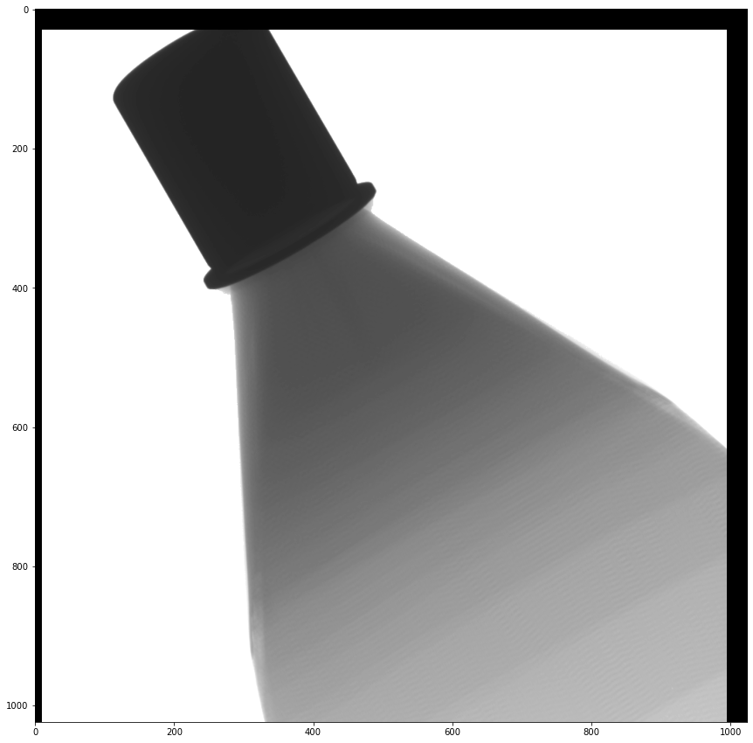
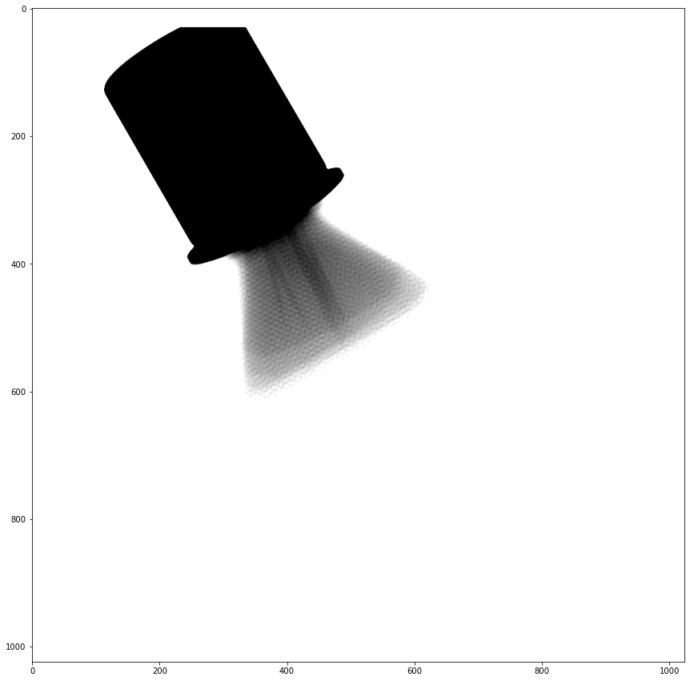
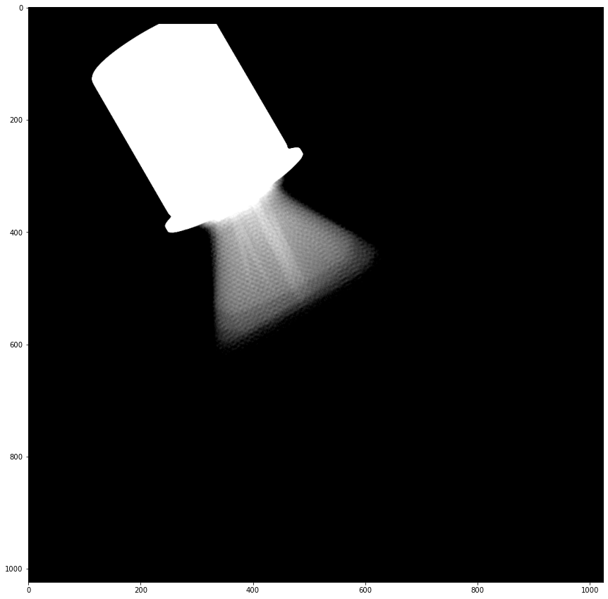
DEFECT DETECTION on RADIOSCOPIES using AI
Images Database
DICOM files
Image Pre-treatment
Extract images in PNG format (16 bits) ► each pixel can have a value between 0 and 65535
Remove black borders
Filter intensity range
= intensity where “wrinkle” can be detected
Invert intensity scale (Normalisation)
Air = 0 (black) and Stainless steel ring = 65535 (white)
Manually check & filter positives / negatives images 1 by 1
positives images = starflex with defect (wrinkle)
negatives images = starflex without defect (no wrinkle)
Create 2 separates folders:
/pos_png_checked = positives images
/neg_png_checked = negatives images
28

Slide 29
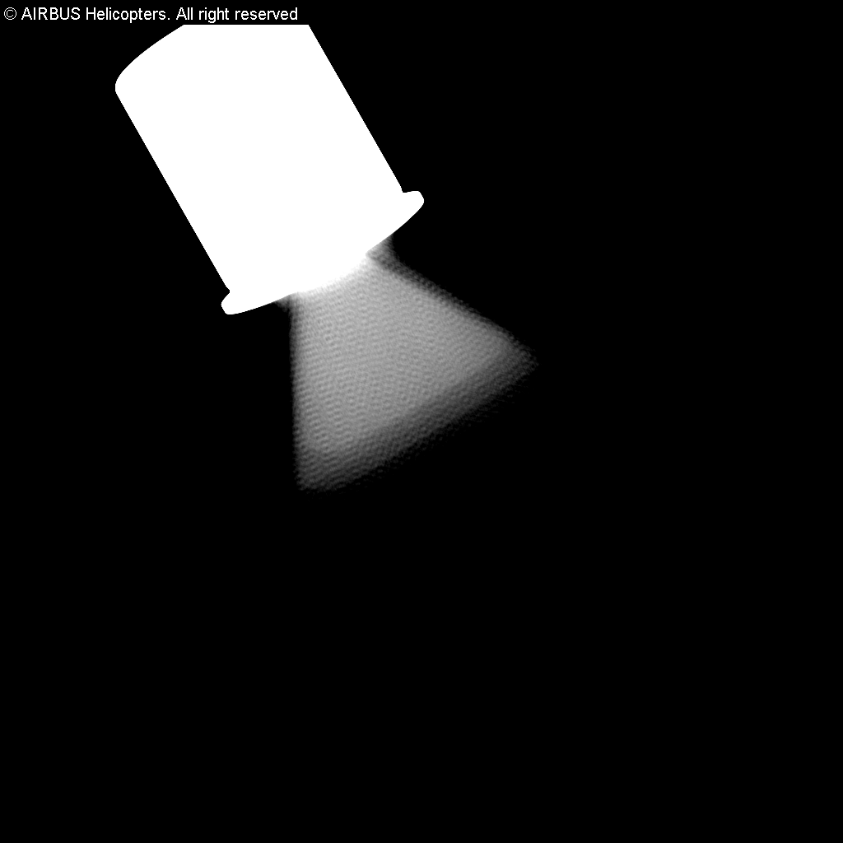
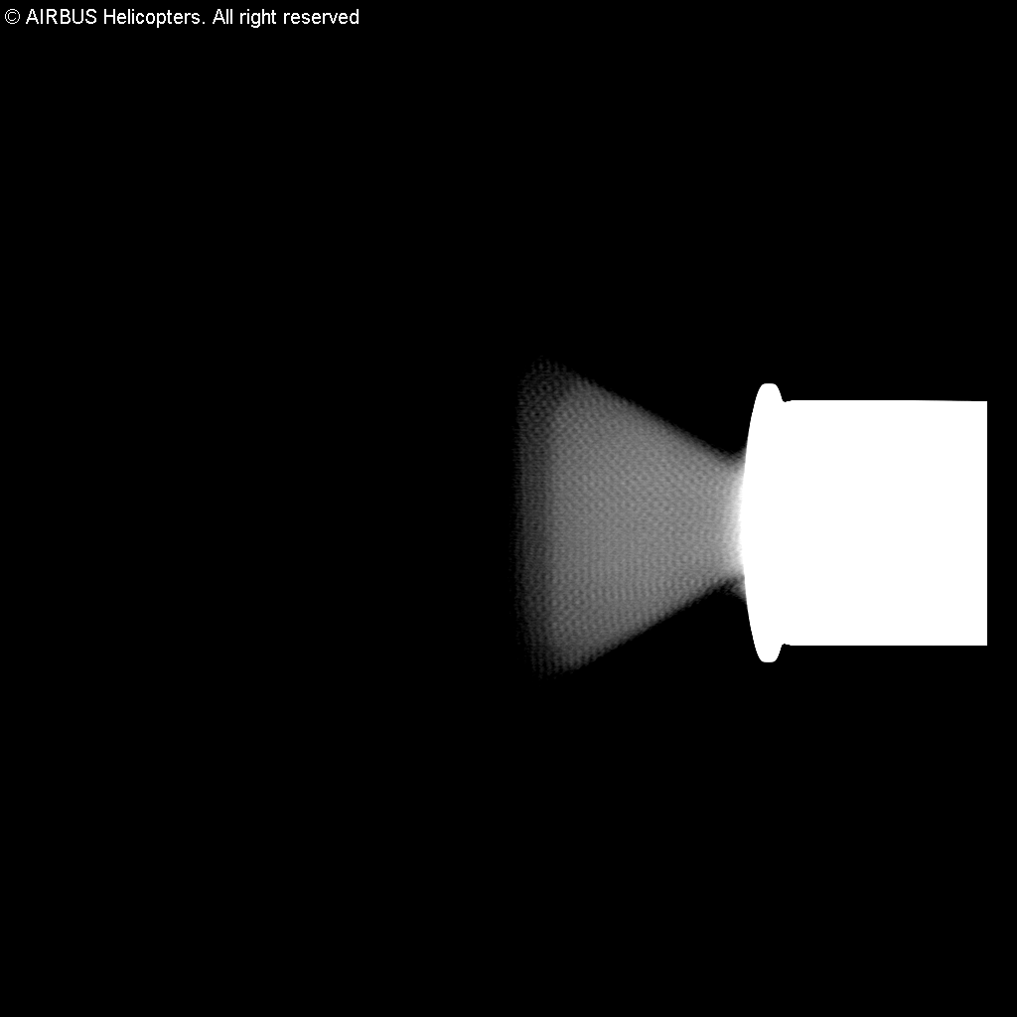
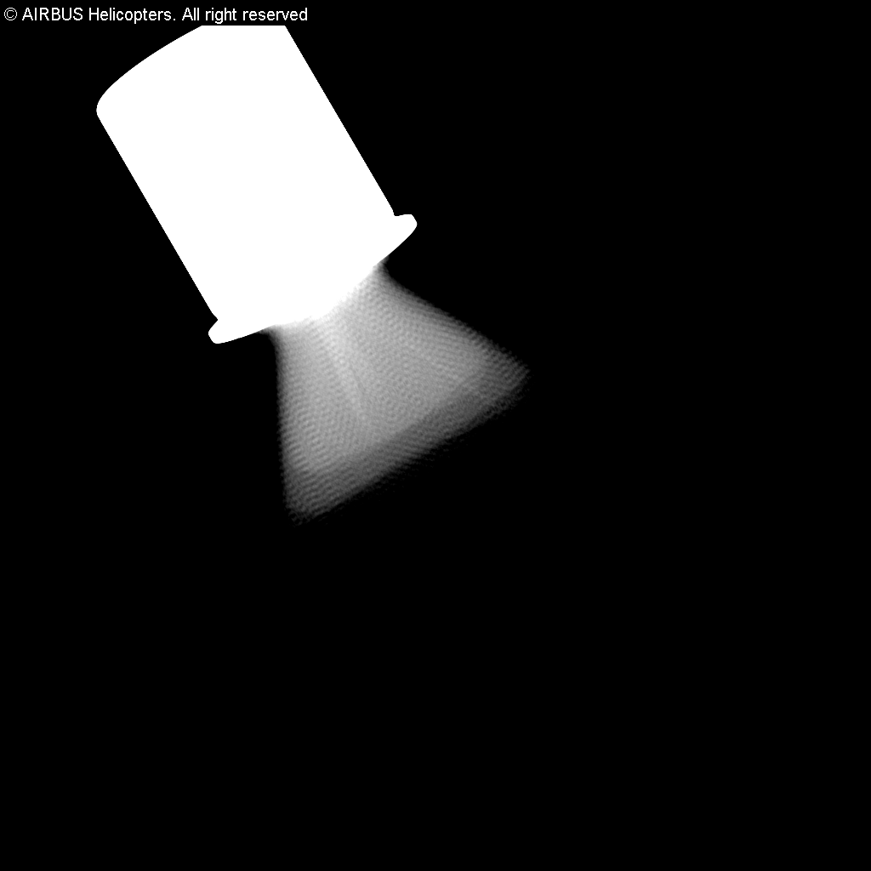
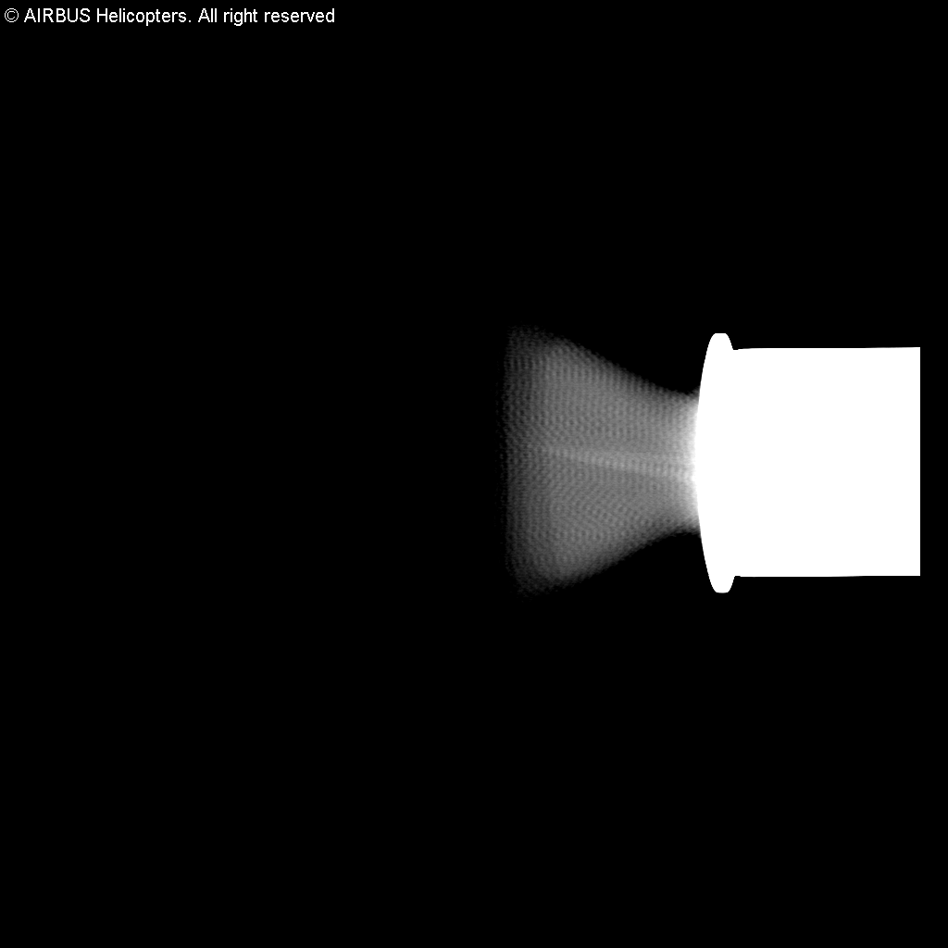
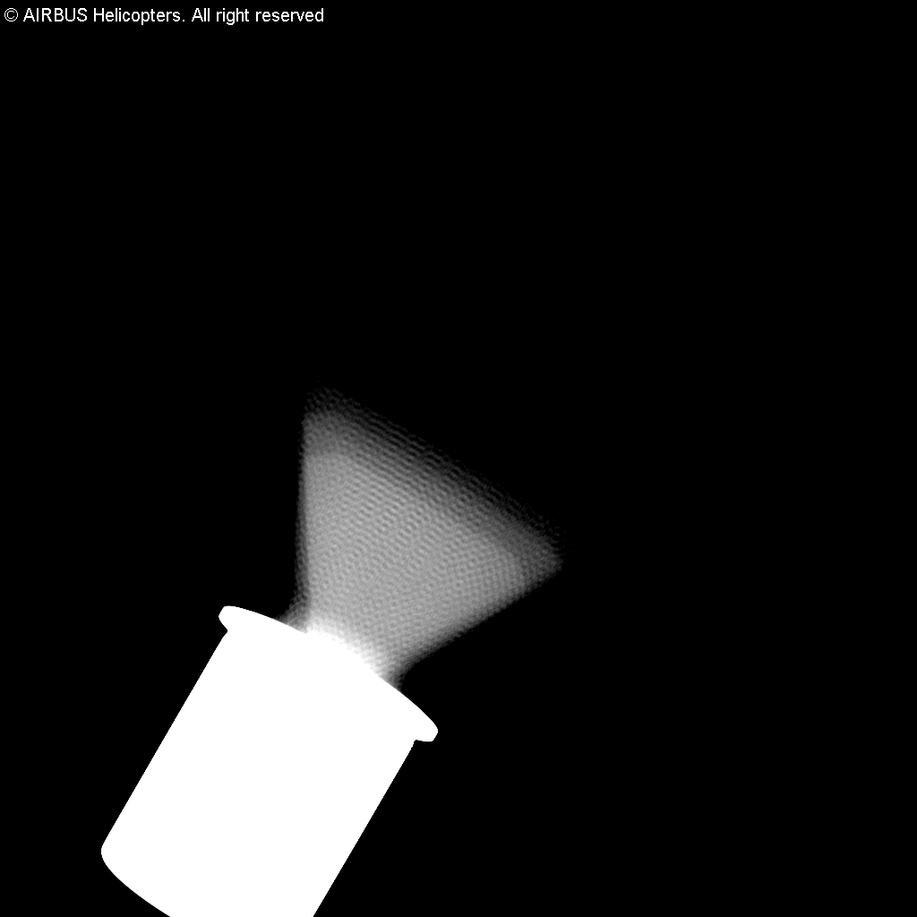
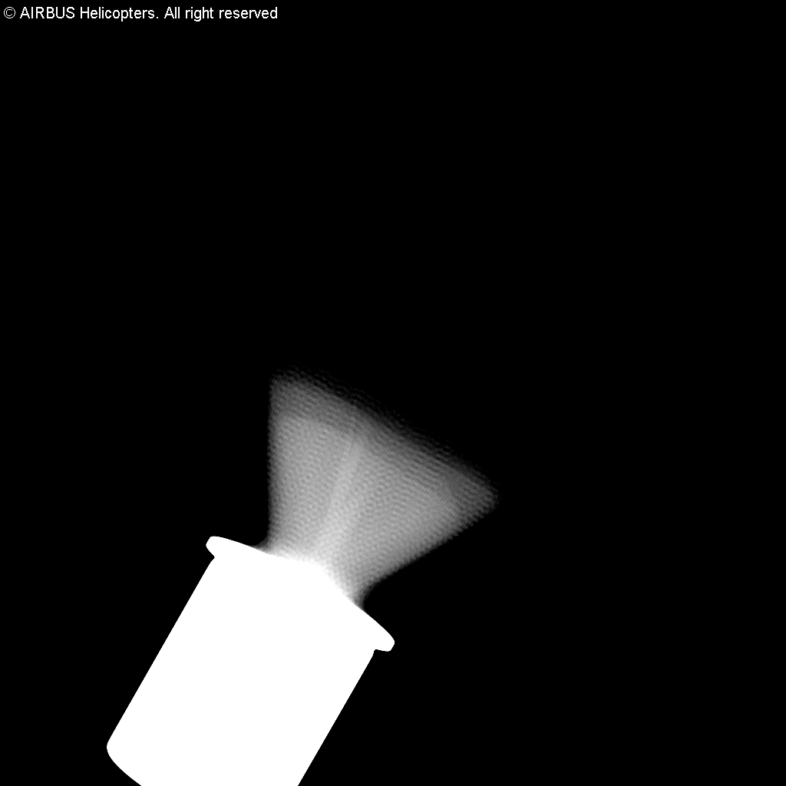
DEFECT DETECTION on RADIOSCOPIES using AI
Images Database
Negatives images :
200 images
without defects
Positives images :
345 images
with defects
29
"This document is the property of AIRBUS, no part of it shall be reproduced or transmitted without express prior written authorization of AIRBUS and its contents shall not be disclosed". © AIRBUS 2024

Slide 30
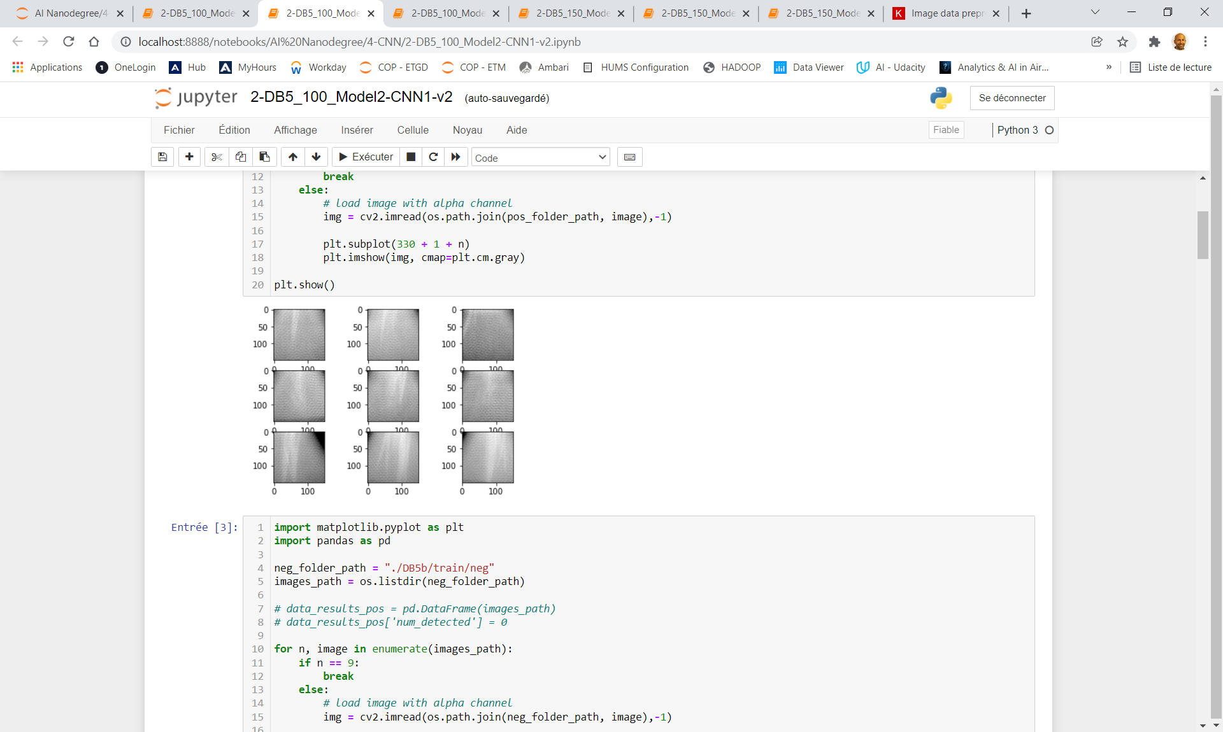
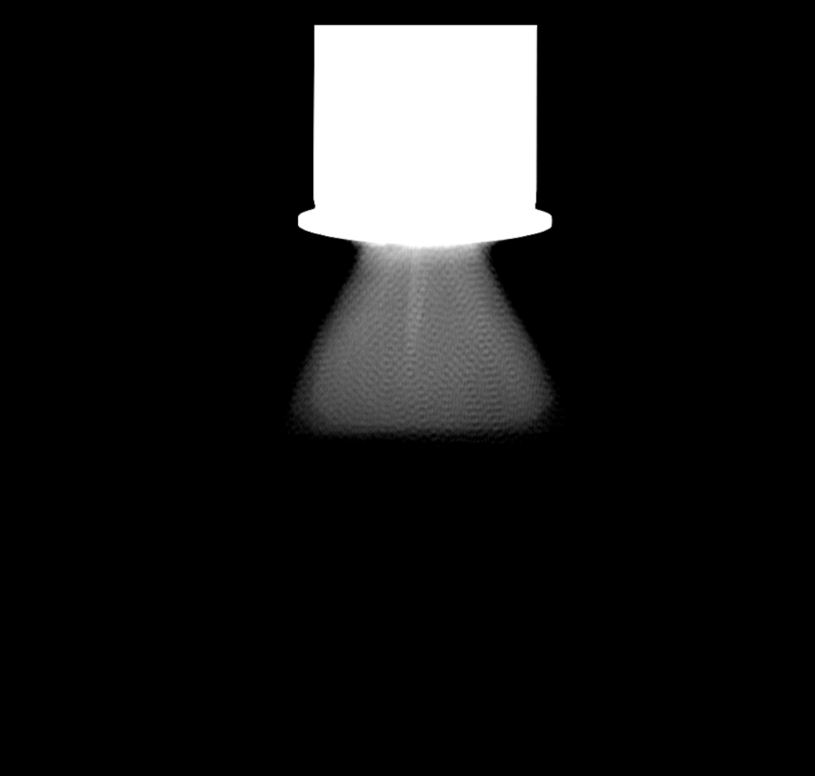
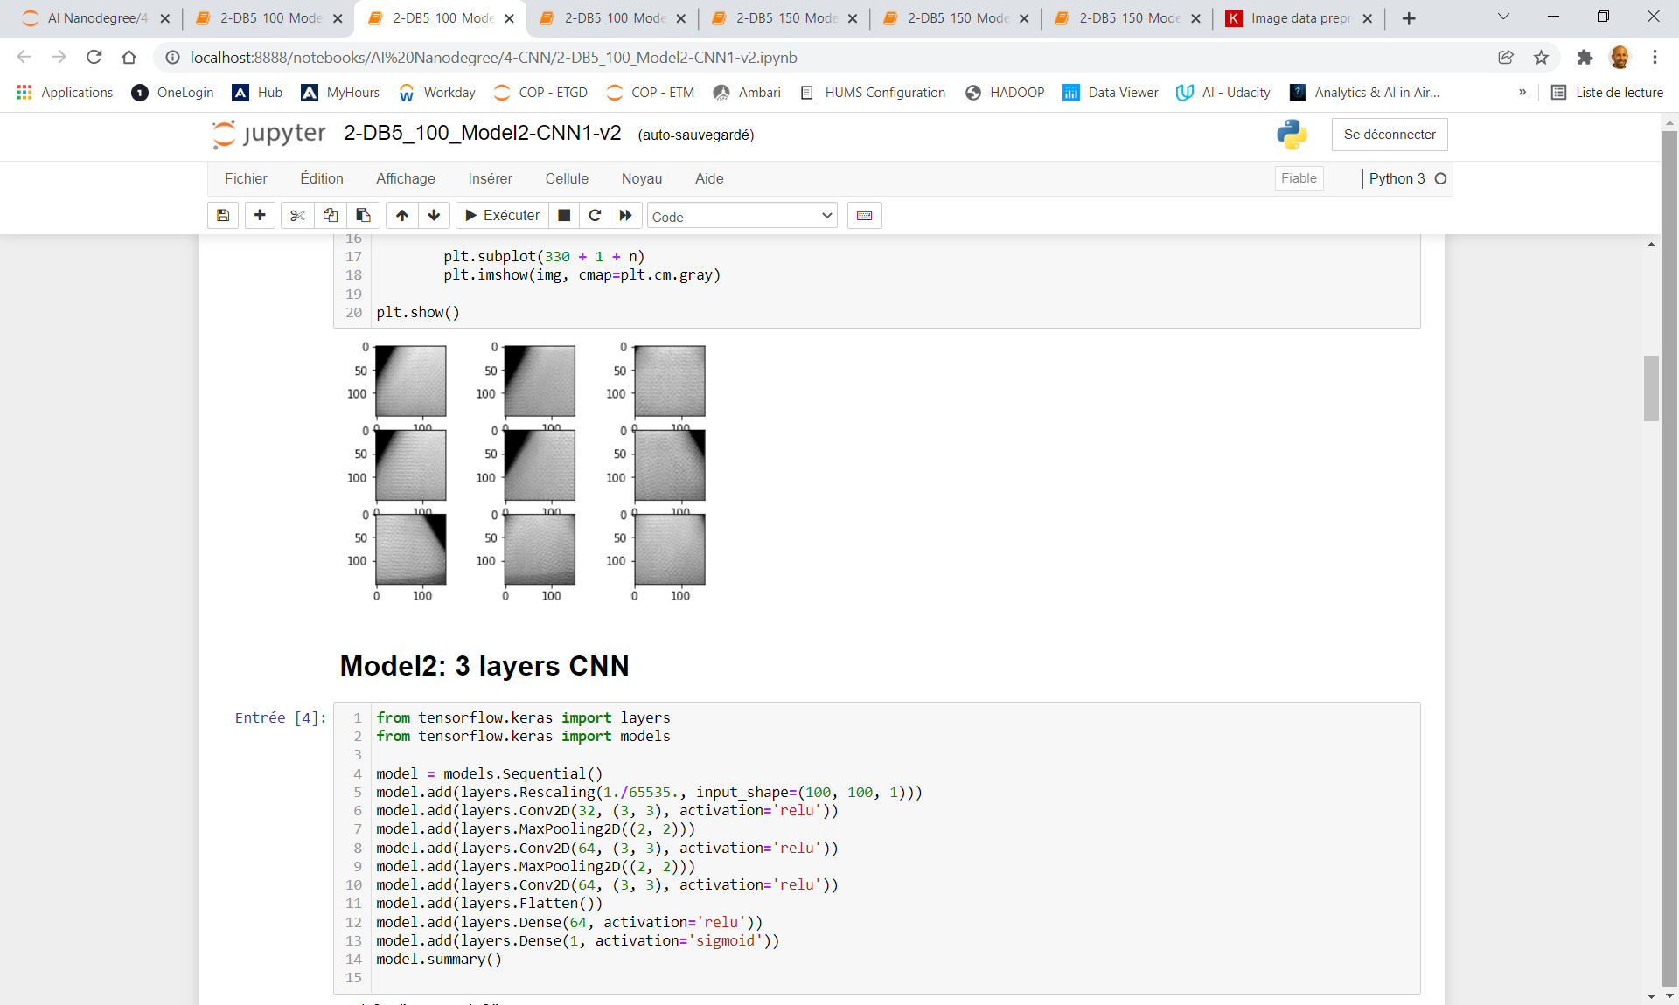
DEFECT DETECTION on RADIOSCOPIES using AI
1 - CLASSIFICATION Model
Positive (defect)
> 98% accuracy for classification
Negative (no defect)
“Full image”
"This document is the property of AIRBUS, no part of it shall be reproduced or transmitted without express prior written authorization of AIRBUS and its contents shall not be disclosed". © AIRBUS 2024

Slide 31
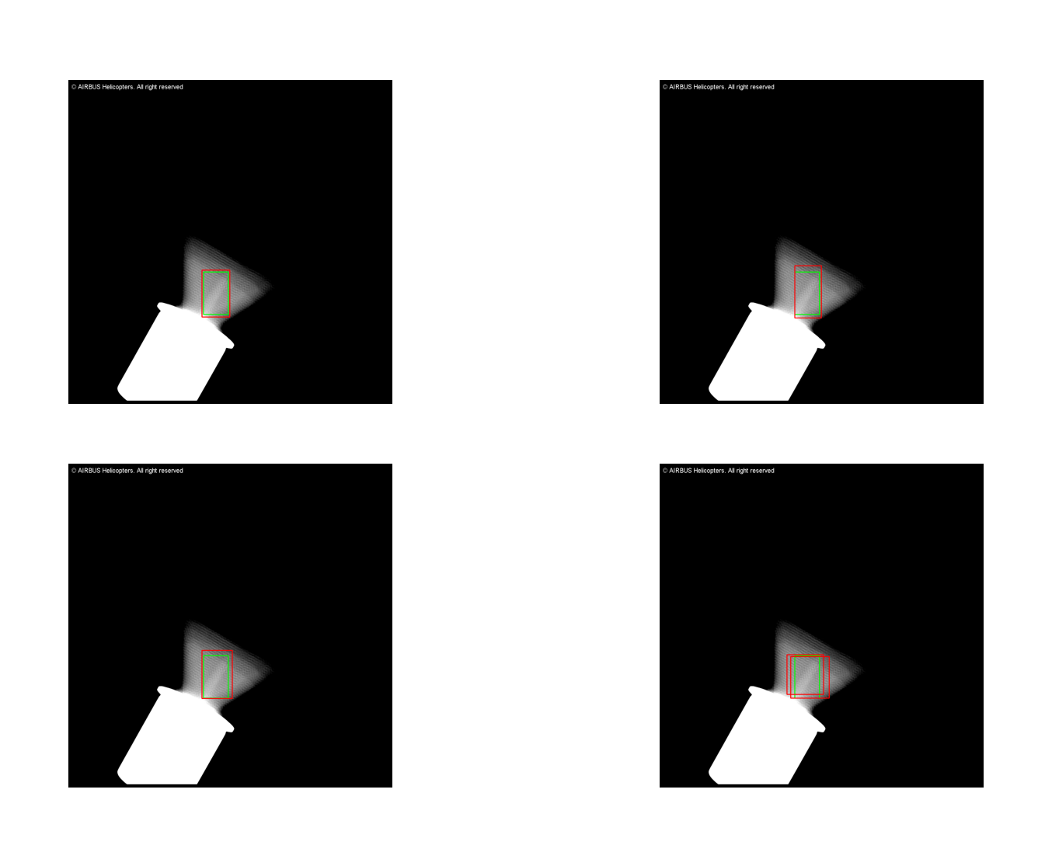
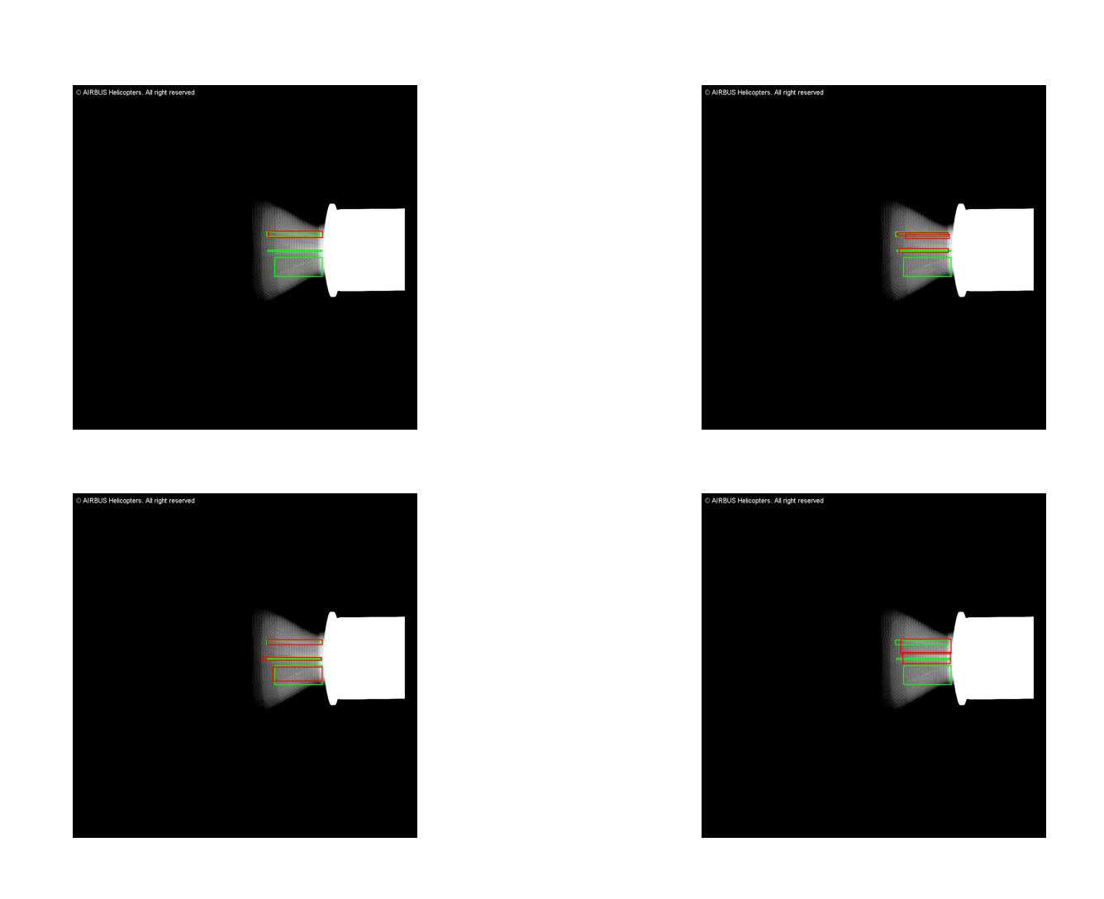
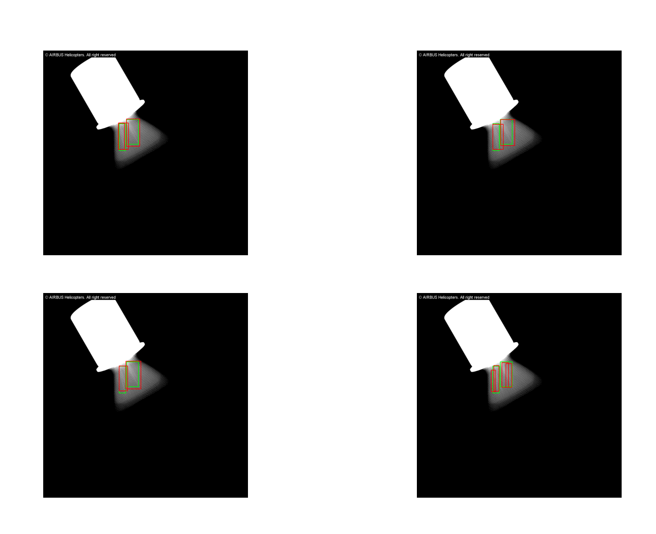
DEFECT DETECTION on RADIOSCOPIES using AI
2- DETECTION BOX Model using YOLO (You Only Look Once)
Ground truth
Results from HACKATHON AI
Prediction
31
"This document is the property of AIRBUS, no part of it shall be reproduced or transmitted without express prior written authorization of AIRBUS and its contents shall not be disclosed". © AIRBUS 2024

Slide 32
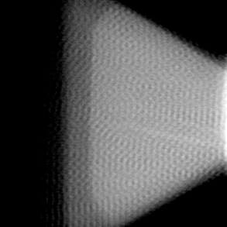
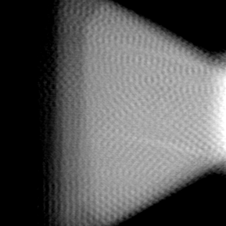
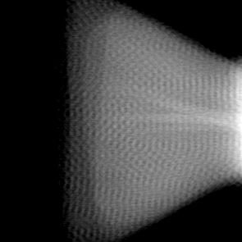
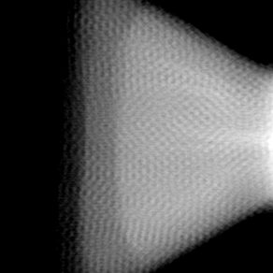
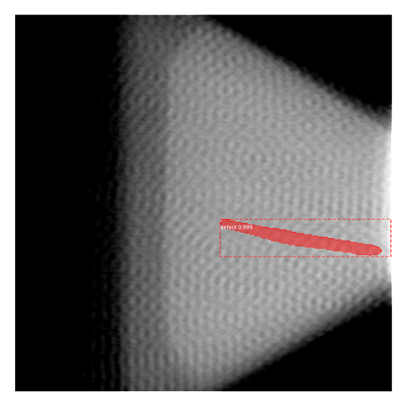
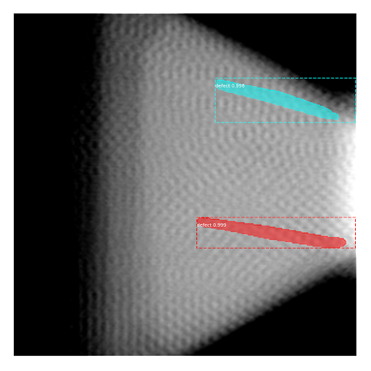
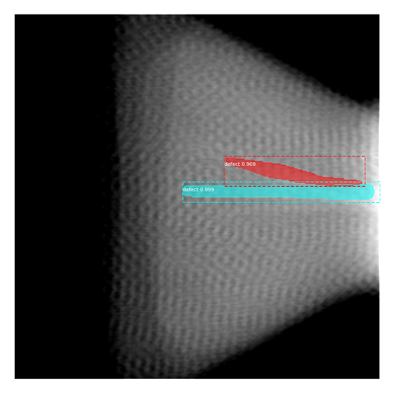
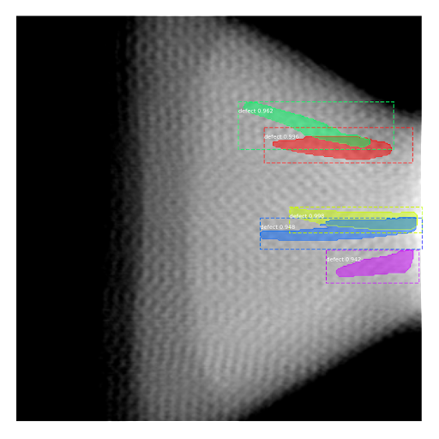
DEFECT DETECTION on RADIOSCOPIES using AI
3 - INSTANCE SEGMENTATION Model using Mask RCNN
Inputs
Predictions
32
"This document is the property of AIRBUS, no part of it shall be reproduced or transmitted without express prior written authorization of AIRBUS and its contents shall not be disclosed". © AIRBUS 2024

Slide 33




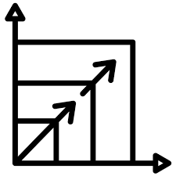

Why using Computer Vision Systems ?
Automation and Efficiency
Enhanced Accuracy
Versatility and Wide Application Range
Enhanced User Experience
Cost Reduction
Scalability

